Slide 1
Efficiency in Using the Results of the IEA Studies
Paulina Korsnakova
IEA Secretariat

Slide 2
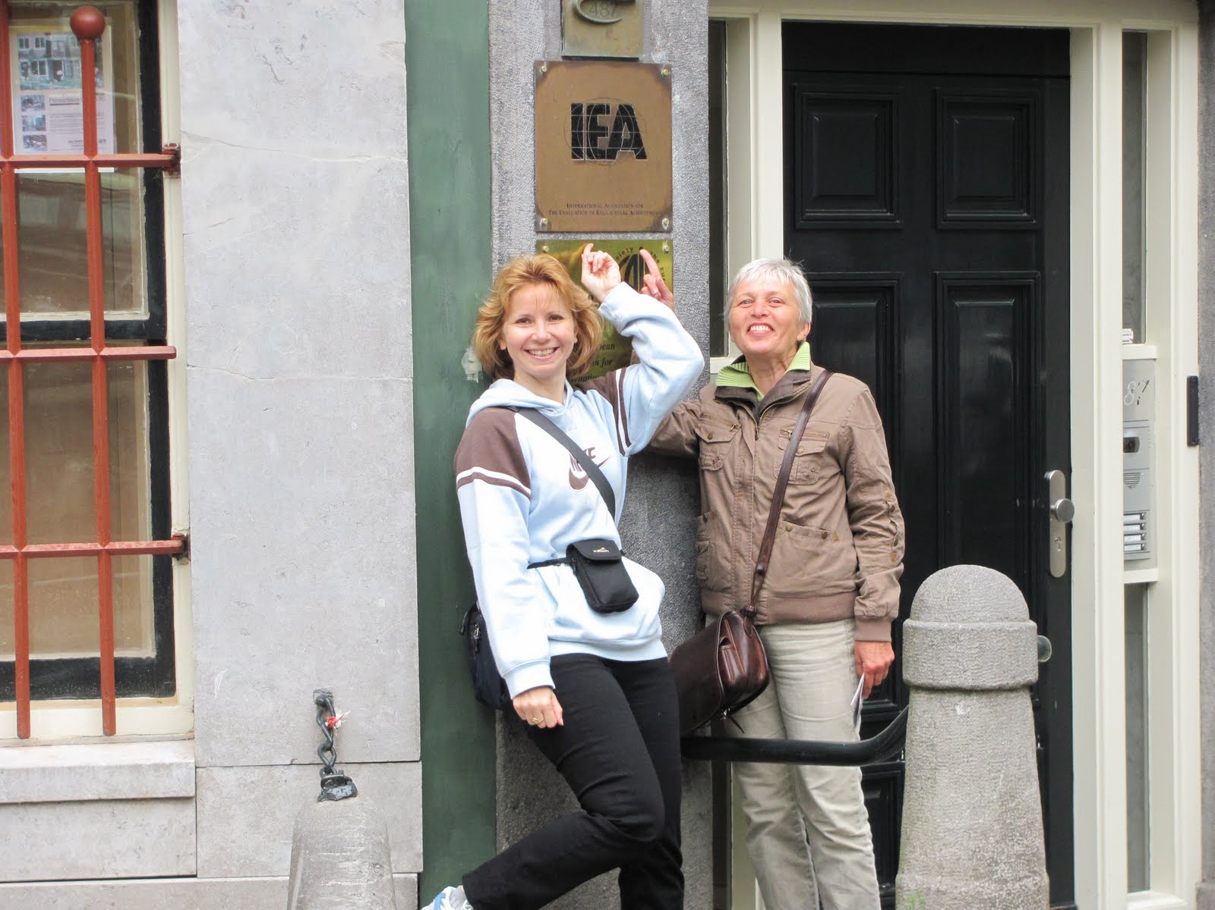










CONTENT
IEA
Studies
Results
Efficiency
Please visit:
www.iea.nl

Slide 3
IEA STUDIES
Intended Curriculum
Implemented Curriculum
Attained Curriculum
Model:
Characteristics:
Framework & Research Questions
Instruments
Field operations
Data quality assurance, management and analysis
Respondents
Cycles
Notes:
TEDS - M

Slide 4
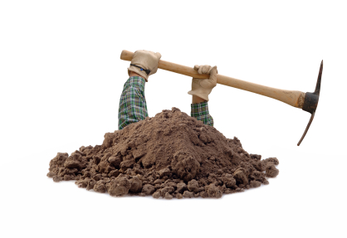
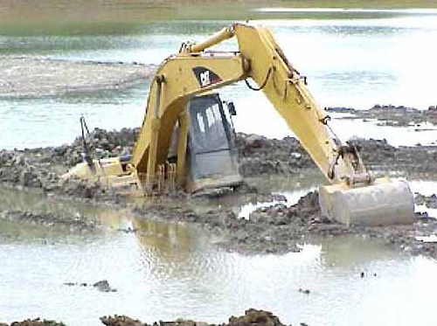
RESULTS (general) = Resources
Ranking (averages)
International Report(s)
Encyclopaedia(s)
Datasets
Technical Report(s)
Journals & Conferences
Trainings

Slide 5

RESULTS (national level)
More detailed PICTURE
(more averages)
Questions
Discussions
Reflection
Ideas (hypothesis)
Vision (preferably shared)
Plan
Networking

Slide 6
Efficiency?
Competent, capable use (being cautious)
Producing an effect (having impact)
The least waste of resources or effort

Slide 7

Thank you for your attention

Slide 8

Questions?

